Slide 1
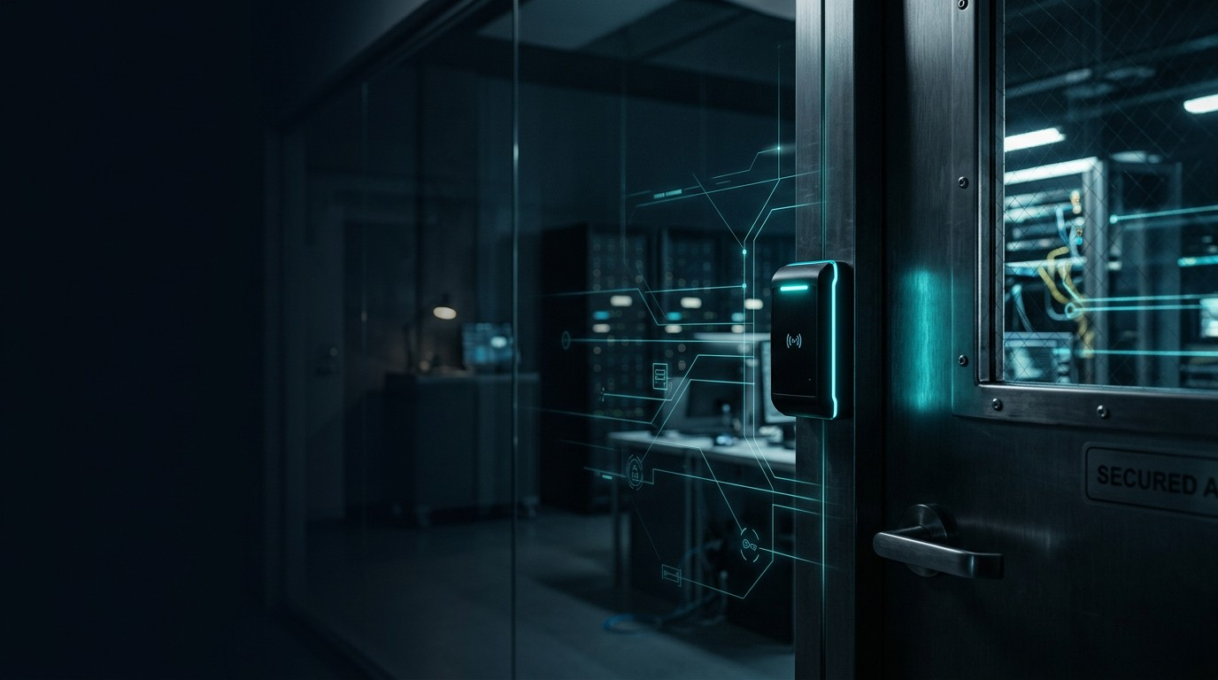
SecureTrack
Software Requirements Specification (SRS)
COMP 225 – Software Engineering Methodologies
Presented by:
(Janet) Adetoun Adewusi
Audrey Anulegeh Wotazea
Yi Ming Ding (Daniel)
(Fahir) Fahir Mokhammad Sarvar
Samuel Young
Details:
Date: April 16, 2026
Semester: Winter 2026
Section #:
Notes:
Welcome, everyone, to our presentation on the Software Requirements Specification for SecureTrack. This project was developed as part of COMP 225 – Software Engineering Methodologies during the Winter 2026 semester. Today, our team will walk you through the core requirements, design models, and system behaviors that define the SecureTrack platform.

Slide 2

Meet the Team
Adetoun Adewusi
she/her
Audrey Anulegeh Wotazea
she/her
Yi Ming Ding
Fahir Mokhammad Sarvar
Samuel Young
Notes:
Before we dive into the details, I'd like to quickly introduce the team behind the SecureTrack SRS. Our group includes myself, Janet Adewusi, along with my colleagues Audrey Anulegeh Wotazea, Yi Ming Ding, Fahir Mokhammad Sarvar, and Samuel Young. We've worked collaboratively to gather requirements and design the architecture for this system.

Slide 3

Project Contents
SRS
Introduction & Scope
Purpose, system overview, and boundaries
Use Case Diagrams & Descriptions
User interactions and functional requirements
Swim Lane Activity Diagram
Cross-functional movement tracking workflows
Domain Class Diagram
System entities, attributes, and relationships
Sequence Diagram
Chronological message passing between objects
State Machine Diagram
Lifecycle of equipment movement requests
Notes:
Here is an overview of what we will cover today. We'll start with the Introduction and Scope to understand the problem SecureTrack solves. Then we'll look at the Use Case Diagrams to see how users interact with the system. We'll follow a specific process via the Swim Lane Activity Diagram. After that, we'll dive into the technical architecture with the Domain Class Diagram, followed by the Sequence Diagram, and finally, the State Machine Diagram. Let's get started.

Slide 4

Introduction & Scope
Purpose
SecureTrack is a software-based laboratory equipment tracking and theft‑prevention system designed to control access, monitor equipment movement, and prevent unauthorized removal.
Project Scope
Access control & User authentication
Equipment registration & tracking
Movement authorization workflow
Real‑time alerts & Audit logging
Notes:
To begin, let's talk about why SecureTrack exists and what it covers. The primary purpose of SecureTrack is to solve the problem of missing or misplaced laboratory equipment. It's a software-based system designed to prevent theft by tracking where equipment is and controlling who has access to it. As for our scope, the project focuses on four main pillars: first, access control and user authentication to ensure only authorized personnel use the system. Second, comprehensive equipment registration and tracking using RFID. Third, creating a formal workflow for authorizing the movement of equipment. And finally, providing real-time alerts and detailed audit logging so administrators have full visibility into lab operations.

Slide 5

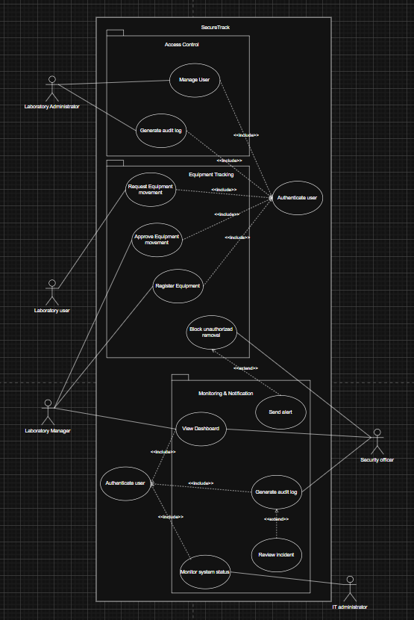
Packaged Use Case Diagram
Use Case Diagram Link: [Insert link here]
Notes:
Here we see our Packaged Use Case Diagram. This provides a high-level view of how different users interact with the SecureTrack system. We've grouped related use cases into functional packages to simplify the architecture. You can see the main actors—such as Lab Users, Administrators, and IT Staff—and how they connect to broad system capabilities like Authentication, Equipment Management, and Monitoring. A link to the full interactive diagram is provided at the bottom of the slide for further review.

Slide 6
Use Case Brief Descriptions (1/2)
Use Case | Actors | Brief Description
Authenticate User | Laboratory User | Validates identity and grants access.
Validate Entry | Laboratory User | Records authorized entry with timestamp.
Record Exit | Laboratory User | Logs exit events for traceability.
Manage User | Administrator | Creates/updates/deactivates user accounts.
Register Equipment | Lab Admin | Registers equipment and assigns RFID tags.
Request Movement | Lab User | User requests permission to remove equipment.
Notes:
Breaking down the use cases, this first table covers the foundational interactions. For Laboratory Users, the system handles basic tasks like Authenticating, Validating Entry, and Recording Exit. Administrators manage user accounts. A crucial step for tracking is Registering Equipment, where the Lab Admin assigns RFID tags to devices. When a user needs to take a piece of equipment out, they trigger the 'Request Movement' use case, which starts the authorization workflow.

Slide 7
Use Case Brief Descriptions (2/2)
Use Case | Actors | Brief Description
Approve Movement | Lab Manager | Approves or rejects movement requests.
Detect Equipment | Lab User | RFID sensors detect equipment passing through.
Block Removal | Security Officer | Triggers alarm and blocks exit.
Generate Audit Log | Admin/Security | Records all activities.
View Dashboard | Admin/Mgr/Security | Displays real‑time system status.
Send Alert | Security Officer | Sends alerts for unauthorized actions.
Notes:
Continuing on to the second half of our use cases, this table highlights the security and reporting functions. The Lab Manager steps in to Approve Movement requests. If an item is moved, RFID sensors Detect Equipment. If that movement isn't authorized, the Block Removal use case triggers an alarm and notifies the Security Officer via Send Alert. Throughout all this, the Generate Audit Log use case ensures a permanent record is kept, which administrators can monitor using the View Dashboard feature.

Slide 8
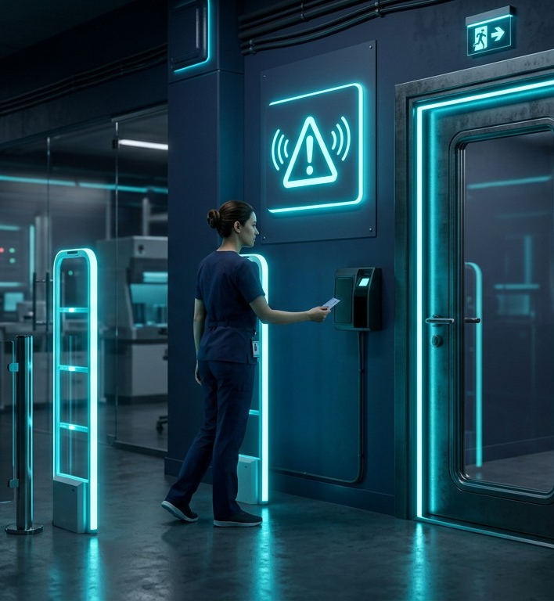
Full Use Case Description
Use Case: Block Unauthorized Removal
Primary Actor
Security Officer
Goal
Prevent unauthorized removal of lab equipment.
Preconditions
Equipment registered & RFID active
User identifiable
Trigger
User attempts to exit with equipment.
Notes:
Let's dive deeper into one of the most critical use cases: Blocking Unauthorized Removal. The primary actor here is the Security Officer, and the goal is straightforward—stop equipment from leaving the lab without permission. For this to work, the equipment must already be registered in the system with an active RFID tag, and the user must be identifiable. The event is triggered the moment a user attempts to exit the facility carrying the equipment.

Slide 9
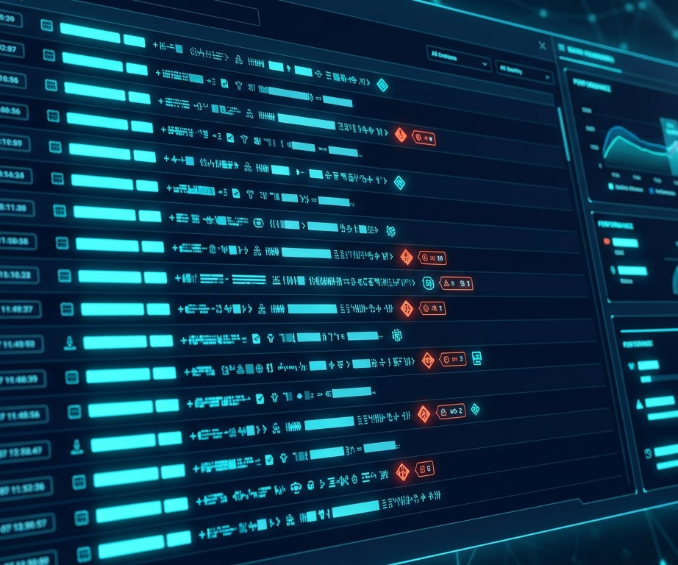
Full Use Case (Continued)
Main Scenario Flow
1
User approaches exit with equipment
Exceptions
Unauthorized:
Alarm triggers, exit blocked, alert sent to Security Officer.
Tag not detected:
Error logged, IT notified of potential sensor failure.
2
RFID tag scanned
3
System checks authorization
4
If authorized → exit allowed
5
System logs event
Notes:
Here is how that scenario flows in practice. It's a five-step process: First, the user approaches the exit with the equipment. Second, the RFID tag is scanned automatically. Third, the system cross-references the database to check if that user has authorization to move that specific item. Fourth, if authorized, the exit is allowed. Fifth, the event is securely logged. However, if the item is unauthorized, the exception flow kicks in: an alarm triggers, the exit is blocked, and security is notified immediately. Additionally, if a tag isn't detected properly, IT is alerted to investigate a potential hardware failure.

Slide 10
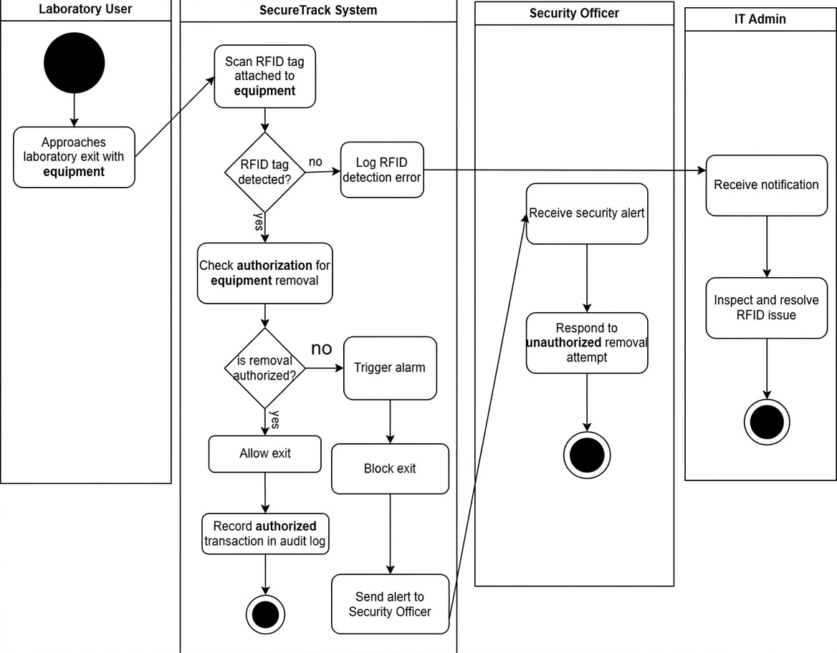
Swim Lane Activity Diagram
Notes:
This Swim Lane Activity Diagram details the step-by-step equipment movement process. We have four distinct vertical lanes representing our actors: Lab User, Lab Manager, Security Officer, and IT Admin. The process begins in the Lab User lane, where they initiate an 'Equipment Movement Request'. This request flows down to the Lab Manager lane, who evaluates it. If the Manager denies it, the flow stops immediately. If approved, the Lab User proceeds to exit the lab. At the exit, the RFID scanner automatically reads the tag. From here, the system encounters a decision node: if everything is authorized, the user exits successfully. However, if the system detects an anomaly—for instance, if the RFID tag is not detected—it alerts the IT Admin, who must 'inspect and resolve the RFID issue'. On the other hand, if the movement is detected as entirely unauthorized, the system immediately alerts the Security Officer, who triggers an alarm and blocks the exit. This clear division of responsibilities ensures no single point of failure during equipment check-out.

Slide 11
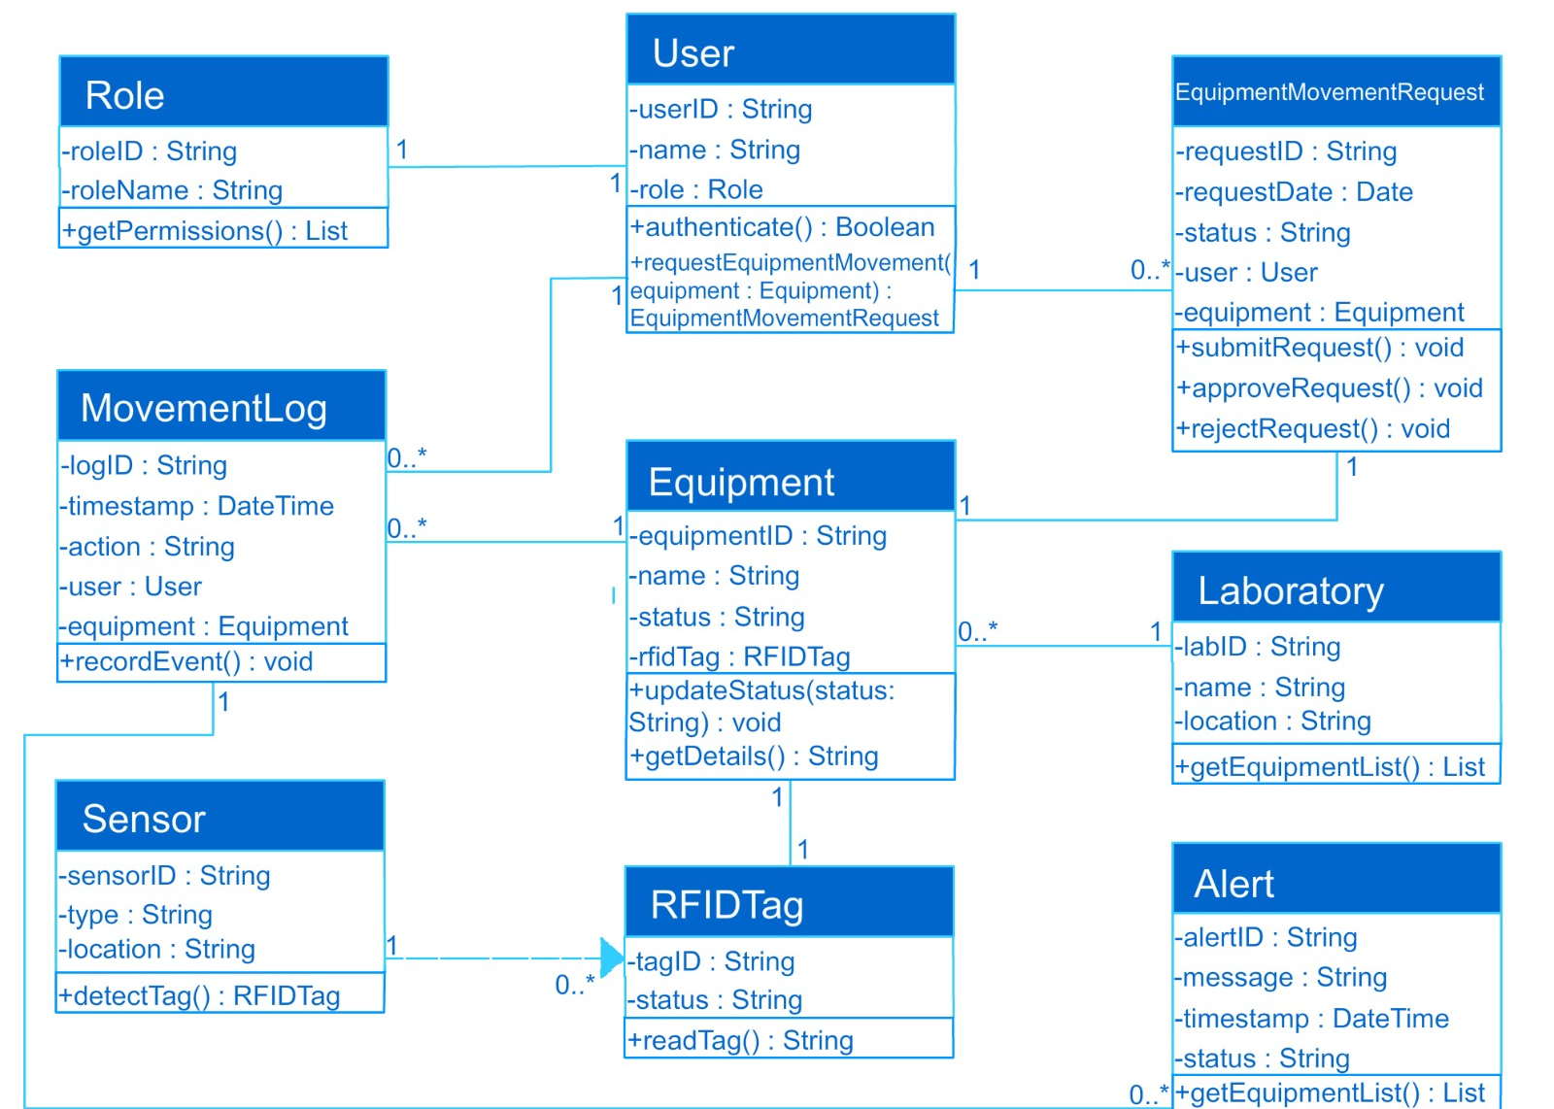
Domain Class Diagram
Notes:
Now let's examine the Domain Class Diagram, which outlines the exact data architecture of SecureTrack. In the center, we have the 'Equipment' class, which contains attributes like Equipment ID, Name, and Status. Each piece of Equipment is linked by a direct one-to-one relationship to an 'RFID Tag' class, which tracks the Tag ID and its current signal strength. On the left side, we have the 'User' class, storing the User ID, Name, and Role Credentials. Users have a one-to-many relationship with 'Equipment Movement Requests', meaning one user can make multiple requests over time. On the right side, the 'Sensor' class connects to the 'Alert' class, triggering notifications if an unauthorized movement is detected. Finally, everything is housed within the overarching 'Laboratory' class, which tracks the Location ID and connected zones. This architecture ensures every physical item and user action translates directly into a rigorously tracked database entity.

Slide 12
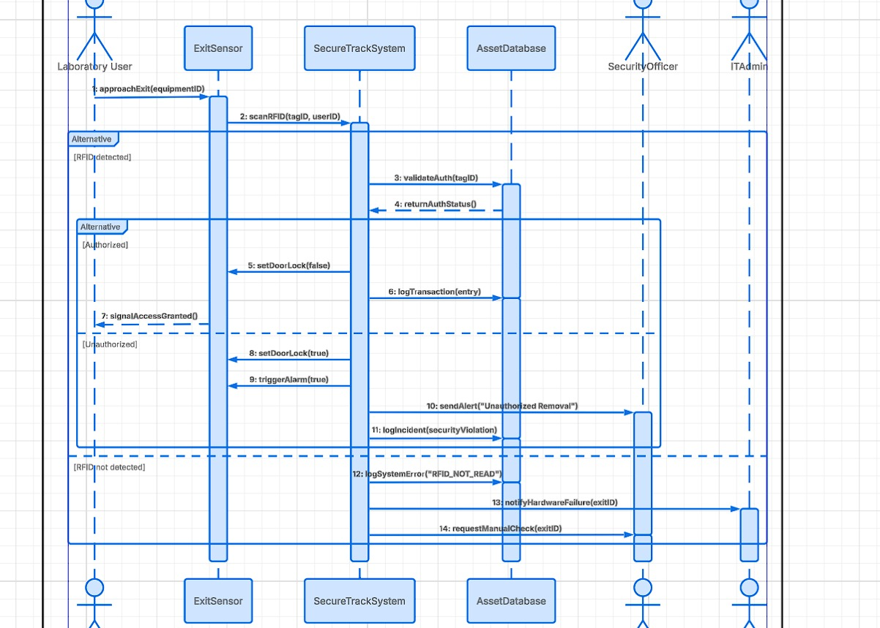
Sequence Diagram
Notes:
This Sequence Diagram provides a chronological view of how the objects in our system interact during a specific scenario. Time flows from top to bottom, and the arrows represent messages or function calls passed between the user interface, the system controller, and the database. This particular diagram illustrates the precise technical sequence required to validate a user and authorize an equipment movement, highlighting the synchronous nature of the security checks.

Slide 13
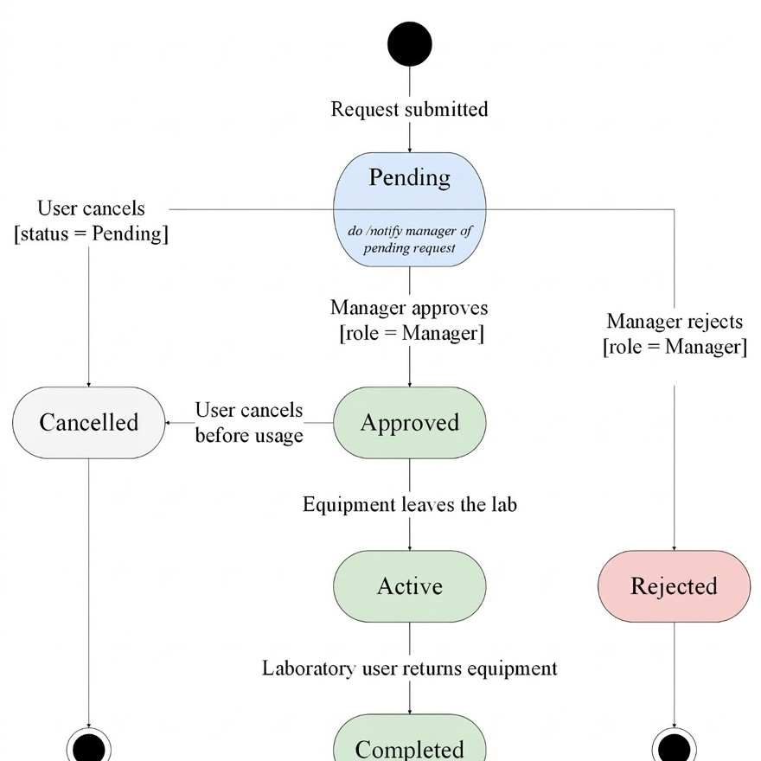
Equipment Movement Request State Diagram
Notes:
Focusing on the lifecycle of a single object, this State Diagram maps out all the possible states for an Equipment Movement Request. When a request is first created, it enters the 'Pending' state. From there, it transitions based on managerial action—either to 'Approved' or 'Denied'. If approved, the equipment can be moved, eventually reaching a 'Completed' or 'Returned' state. This ensures that every request is strictly governed and cannot bypass required approval steps.

Slide 14
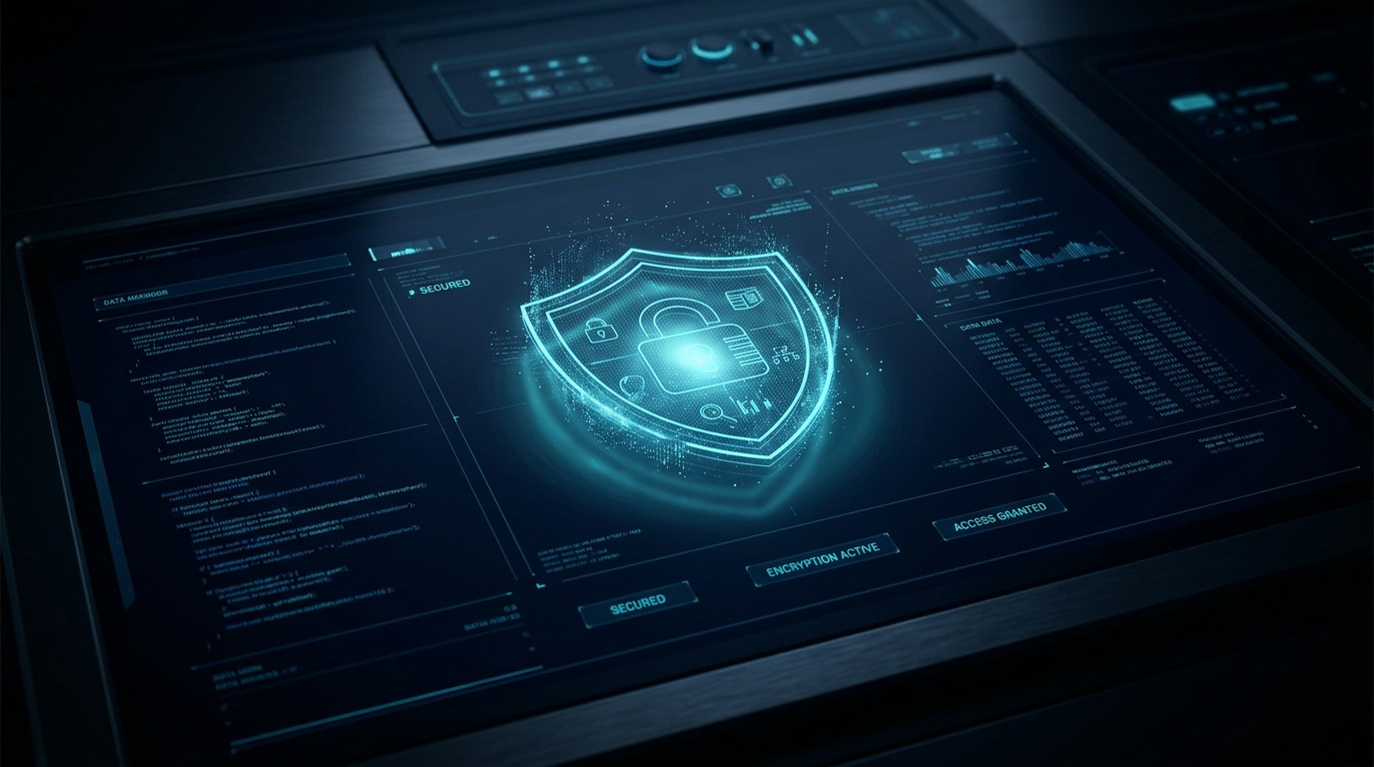
Conclusion
SecureTrack provides a robust, software-driven foundation to eliminate unauthorized equipment removal while maintaining seamless lab operations.
Thank You.
Notes:
To conclude, SecureTrack offers a comprehensive, software-driven solution to the critical problem of laboratory equipment theft. By integrating strict access controls, RFID tracking, structured approval workflows, and robust audit logging, we provide a foundation that eliminates unauthorized removal without disrupting the daily, seamless operations of the lab staff. Thank you very much for your time and attention today. We would be happy to answer any questions you might have.

